Slide 1

Final Project Wood Genus Classification from Microscopic Images Using CNNs and Transfer Learning
Martin Mayer
Instructor: Professor Dmitry Kurochkin, PhD
Teaching Assistants: Andrey Sivachenko, Andrea Hatch, Kurt Rayner, Sathvika Iyengar
CSCI 89 Deep Learning · Harvard University

Slide 2
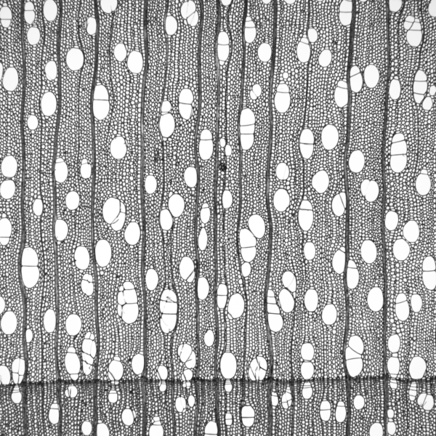
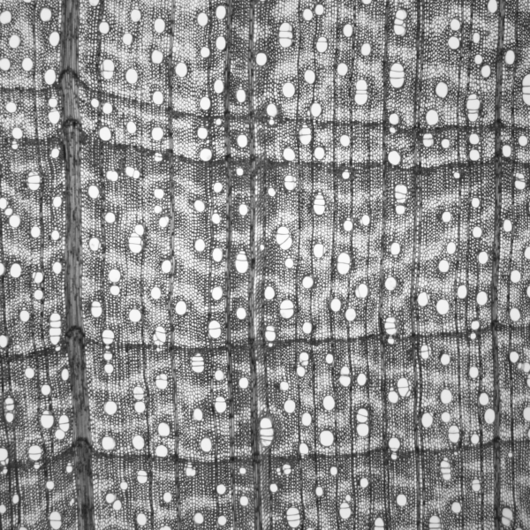
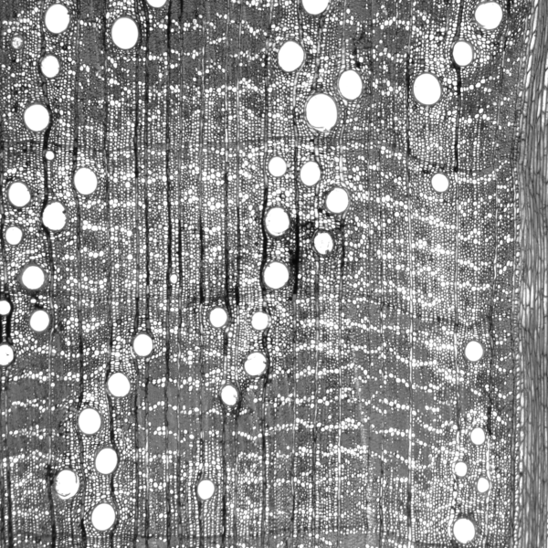
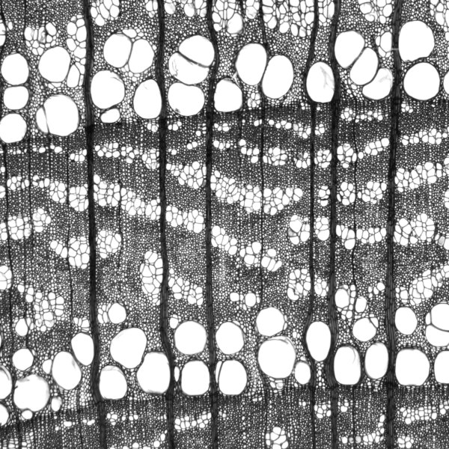
Project goal
The problem
Build a CNN-based image classifier to identify the wood genus from microscopic wood images.
Prepare a leakage-aware image dataset
Train a Keras transfer-learning model
Evaluate performance at image and specimen level
Explore whether learned filters relate to wood-anatomy characteristics
Betula (Birch)
Acer (Maple)
Quercus (Oak)
Ulmus (Elm)

Slide 3
Why genus classification?
Family
Genus
Species
Broad group of related genera
Practical middle level (this project)
Finest, most specific rank
Broader
Finer
Family groups many related genera; species is the finest, most specific rank.
Genus sits in between — a practical middle level of granularity.
More specific than family: it captures meaningful anatomical distinctions.
More feasible than species: enough labeled specimens per class to train and evaluate reliably.

Slide 4
Dataset
XDD_015 / WIG_v1.2.1_600 microscopic wood image dataset
Metric | Raw archive | Retained dataset
Genera | 33 | 17
Specimens | 540 | 466
Images | 7,051 | 5,992
Only genera with at least 12 independent specimens were retained, enabling a leakage-aware specimen-level split.

Slide 5
What the images look like
Each specimen contains a stack of microscopic transverse-section images.
Each image is 600 × 600 pixels and grayscale.
The images show anatomical structures such as vessels, rays, and parenchyma.
The number of images per specimen varies.
Betula (Birch)
Examples:
- Vessels: Large, white circular or oval pores.
- Rays: Narrow, straight bands running across the wood tissue.
- Parenchyma: Smaller cells forming lighter tissue around vessels or in thin bands.

Slide 6
Leakage-aware split
Specimen A
all its images together
Specimen B
all its images together
Specimen C
all its images together
Train
Validation
Test
Images from the same physical specimen are highly correlated.
Splitting by image would leak specimen information across train and test.
We split by specimen: every image from a specimen stays in one partition.
This gives a more realistic estimate of generalization to unseen specimens..

Slide 7
Data preparation pipeline
Step 1
HDF5 archive
Raw images and taxonomy
Step 2
Metadata manifest
One row per image
Step 3
Genus filtering
Keep genera with ≥12 specimens
Step 6
Model loaders
Resize, preprocess, augment
Step 5
PNG export
Preserve split and labels
Step 4
Specimen-level split
Train / validation / test
Automated, reproducible flow from raw archive to model-ready image folders.

Slide 8
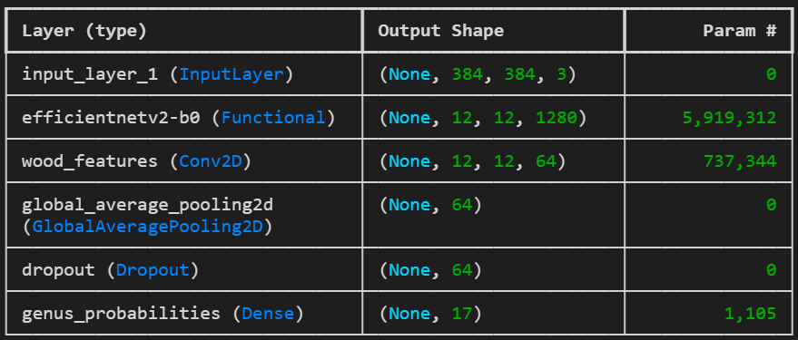
Model architecture
Input
384 × 384, grayscale repeated to 3 channels
EfficientNetV2B0 backbone
pretrained on ImageNet
Convolution — 64 filters
Global pooling
Dropout
regularization
Dense — 17-way softmax
genus probabilities

Slide 9
Training strategy
Stage 1 — Train the head
Stage 2 — Fine-tune
Freeze the pretrained backbone.
Train only the new classification head.
Learning rate: 1 × 10⁻³
Unfreeze the final 20 non-BatchNorm layers.
Continue with a lower learning rate (1 × 10⁻⁵).
AdamW optimizer
Early stopping on validation loss
Class weights for imbalance
Two-stage transfer learning with regularization and imbalance handling.

Slide 10
Evaluation design
Image 1 → prob. vector p1
Average image
probabilities
Specimen
prediction
Image 2 → prob. vector p2
Image 3 → prob. vector p3
Image-level: each image is scored independently.
Specimen-level: average the image probabilities across the specimen, then predict.
Specimen-level results are the primary evaluation results.

Slide 11
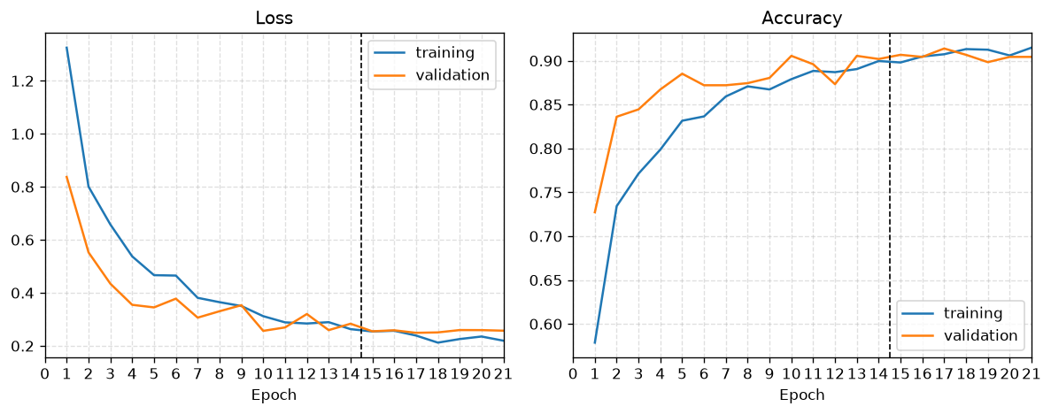
Main results
17-genus classification on the held-out test set
0.884
Specimen-level accuracy
0.864
Specimen-level
macro F1
0.873
Image-level accuracy
0.839
Image-level macro F1
Specimen-level metrics (aggregated across each specimen's images) are the project's primary results.

Slide 12
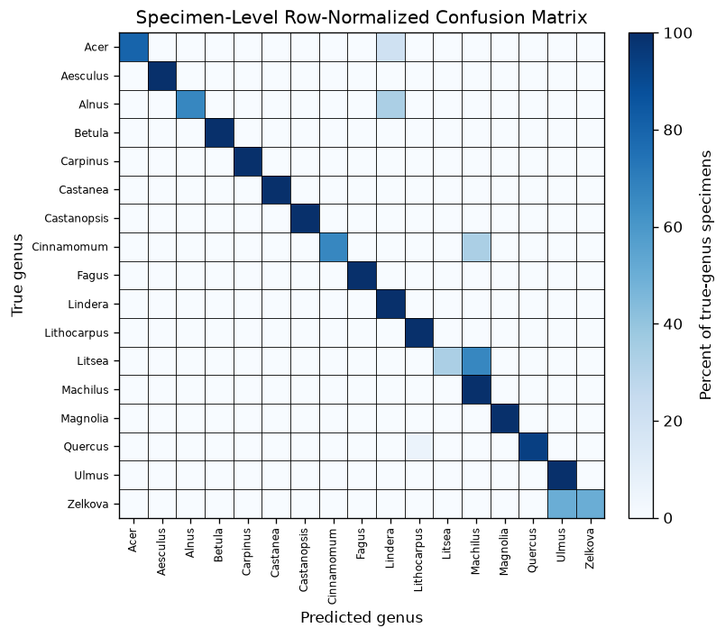
Error analysis
Where it works
Genera with distinctive anatomy are classified reliably.
Specimen-level averaging smooths out noisy single-image errors.
Main confusion patterns
Litsea→ Machilus
Zelkova → Ulmus

Slide 13
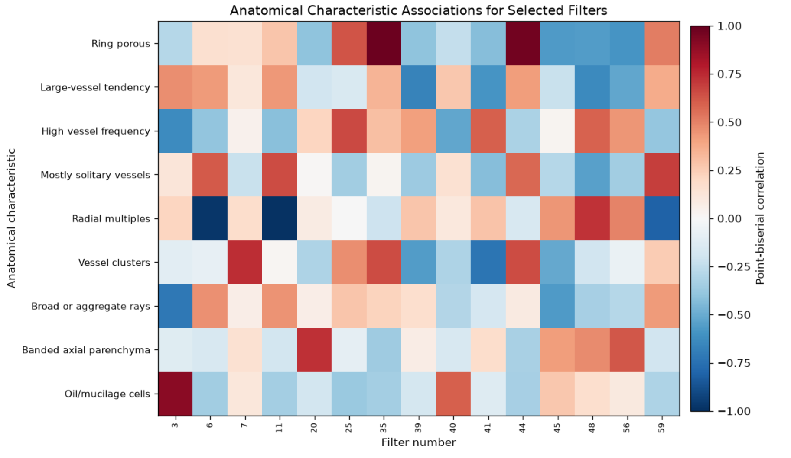
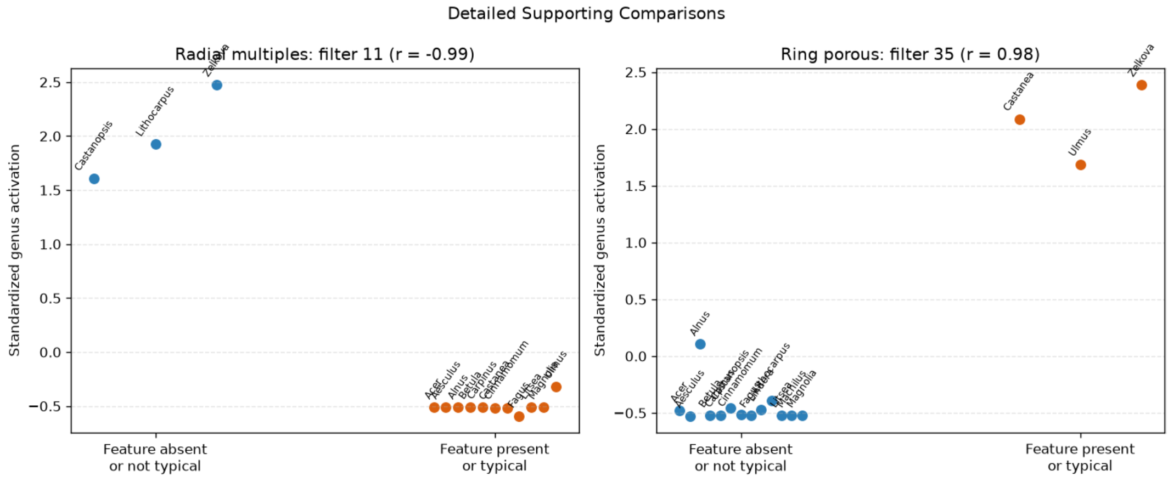
Feature interpretation
Activations from the final convolutional layer were compared with genus-level anatomical traits.

Slide 14
Pros, cons, and lessons learned
Pros
Cons / limitations
Leakage-aware, specimen-level split
Strong held-out specimen-level performance
Practical transfer-learning workflow
Includes an exploratory interpretability analysis
Small number of genera for interpretation
Genus-level anatomy labels are weak labels
No exhaustive architecture search
Lessons learned: preventing data leakage and evaluating at the specimen level mattered more than chasing architectural complexity.

Slide 15
Links
GitHub repository: https://github.com/mayerkrebs/Harvard-CSCI-89-Deep-Learning
Dataset: https://drive.google.com/file/d/1QmX8vWyJzU3U1tOJvRGy-d3xL3XbvAZf/view?usp=sharing
Video presentation: https://vimeo.com/1215653077

